Slide 1
Weekly meeting
By Sheharyar Ali

Slide 2
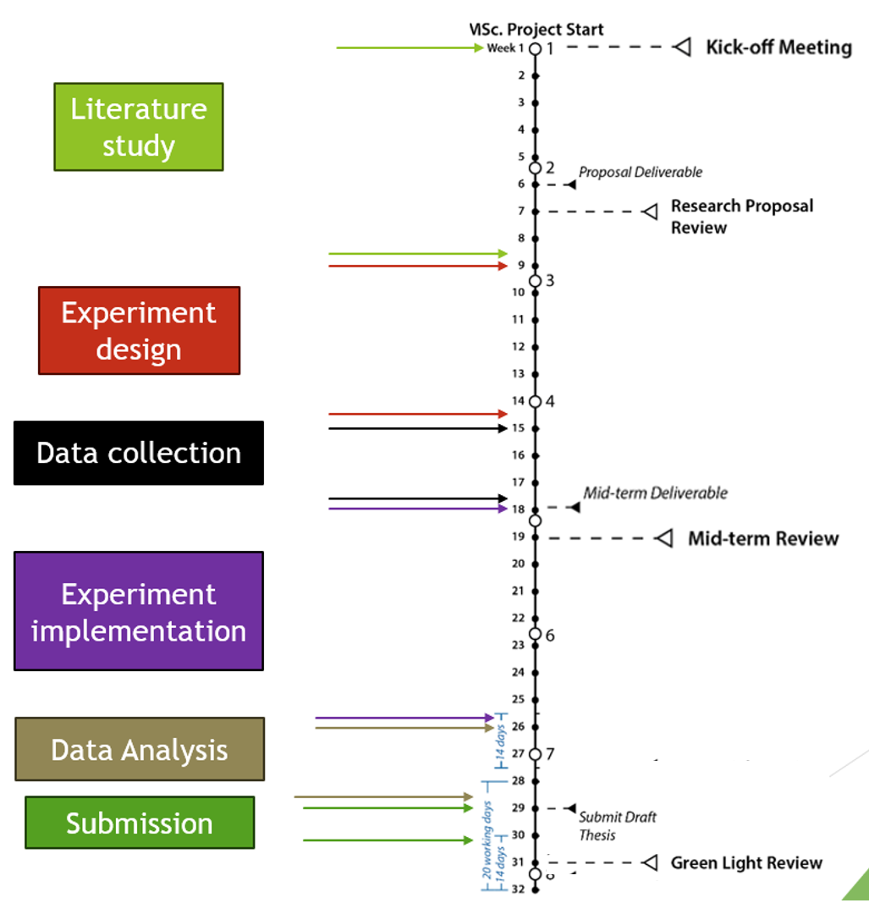

Slide 3
Research questions
What is the main impact of changing field of view on the performance of helicopter pilots when using VR for visual cueing.
What manoeuvre is most impacted by changing field of view?
What is the predicted pilot behaviour for the critical manoeuvre with changing FoV?
What is the actual pilot behaviour for the critical manoeuvre with changing FoV?
What is the effect of changing FoV on pilot performance?
What strategies do pilots employ to overcome adverse effects of changing FoV?

Slide 5
Hypotheses
1. There should be a significant improvement in pilot performance as FoV increases from 20 degrees to 90 degrees for the velocity tracking task
2. There should be no significant improvement in pilot performance as FoV increases from 90 degrees to 140 degrees for the velocity tracking task
3. There should not be a significant change in pilot performance as the FoV increases from 20 degrees to 140 degrees for the pitch tracking task

Slide 6
Some Results
2 participants so far
Got good subjective feedback
The participants were mostly looking at the ground in the middle
Occasionally shifted their gaze to the horizon
As FoV increased, they felt their performance drop as they felt like they were moving faster
Higher FoVs were more “comfortable” because they felt like it was a normal view
Theta task was very jittery. Felt very disorienting. Maybe always do that last

Slide 7
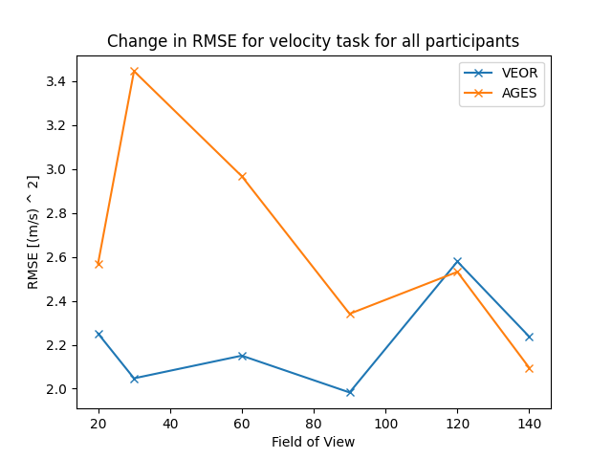
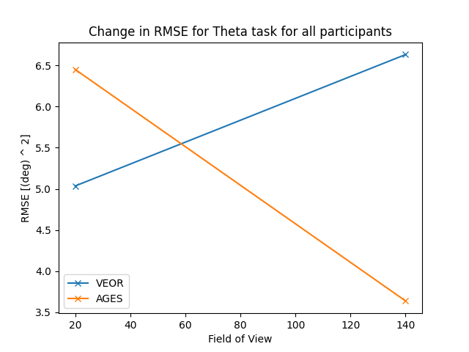
Objective results

Slide 8
Analysis
Do a linear regression analysis to see if there is a trend for the three sets of result:
Hypo 1: There should be a significant negative slope
Hypo 2: There should be no slope
Hypo 3: There should be no slope
Results:
Slope 1: -0.0050585791524208204, p-value = 0.352
Slope 2: 0.0011107950043569305, p-value = 0.921
Slope 3: -0.005066296997429826,

Slide 9
Questions
Statistical Analysis to use

Slide 10
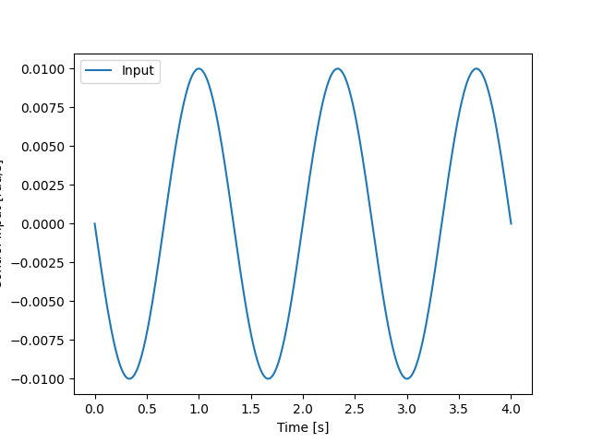
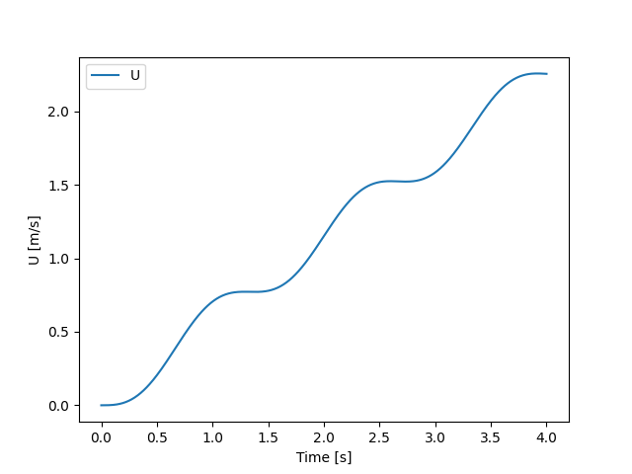
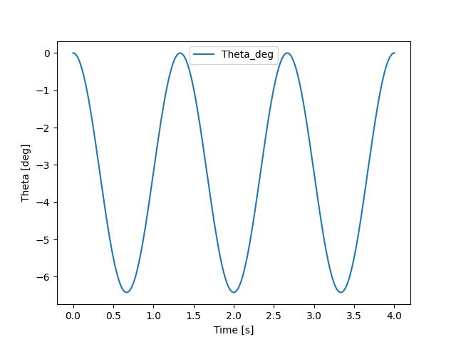
Motion

Slide 11
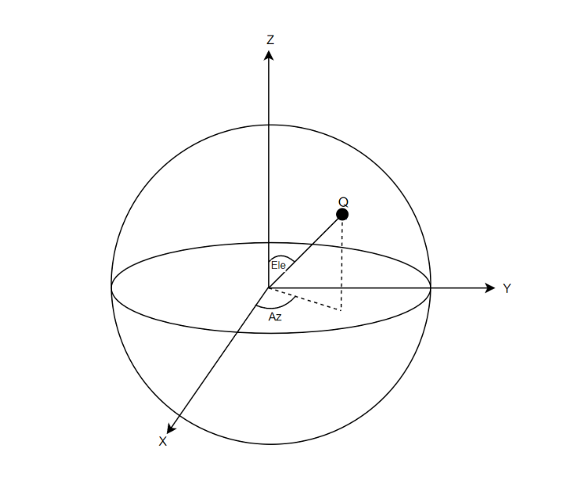


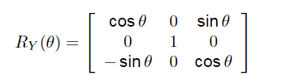
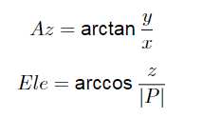

Slide 12
Motion on retina

Slide 13





Analytically calculating the behaviour

Slide 14
Method
Use the input to generate the speed and pitching angles
Fix z to -5 metres (on the ground)
Still need to fix x and y
Fix them based on FoV
For a particular FoV, find the behaviour for different x and y values
Average this behaviour to find the behaviour for this FoV

Slide 15
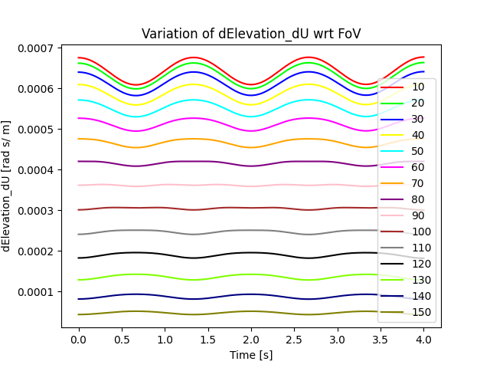
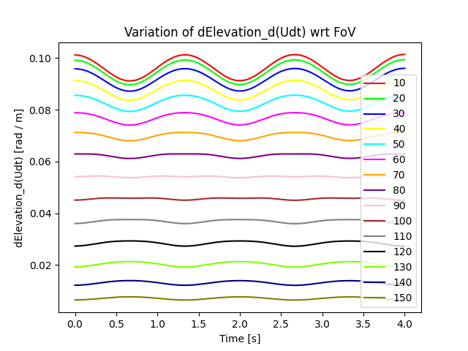
Changes in elevation angle

Slide 16
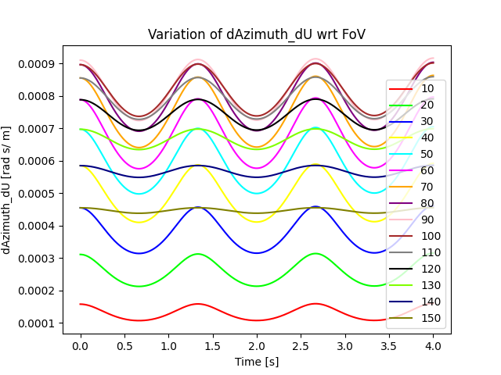
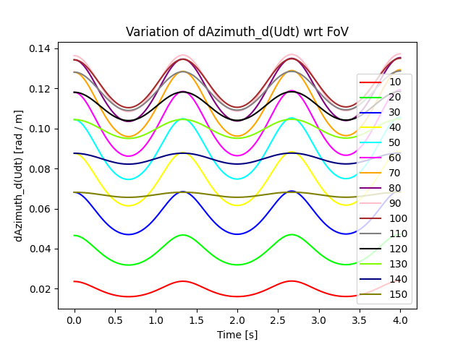
Changes in azimuth angle

Slide 17
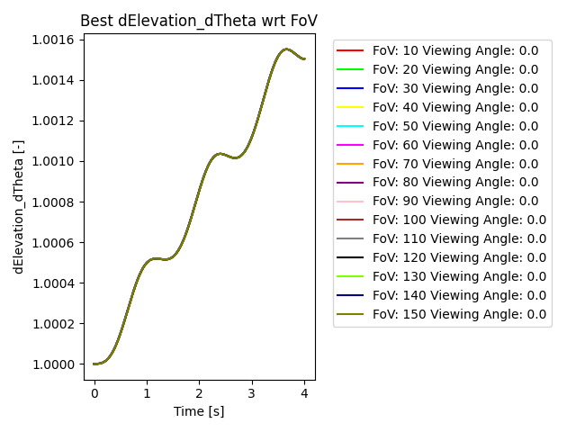
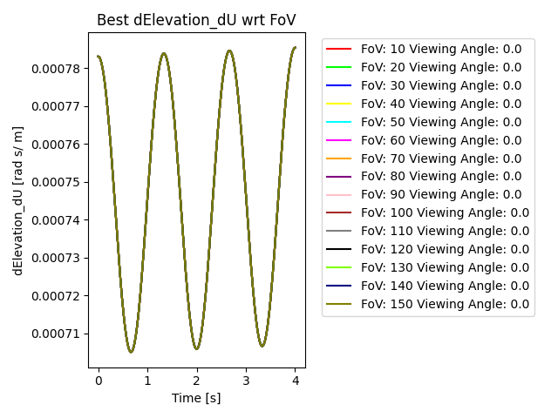
Maximum change for elevation

Slide 18
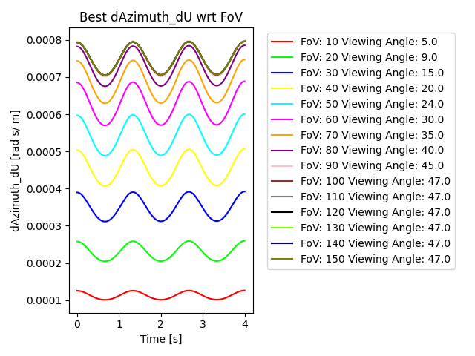
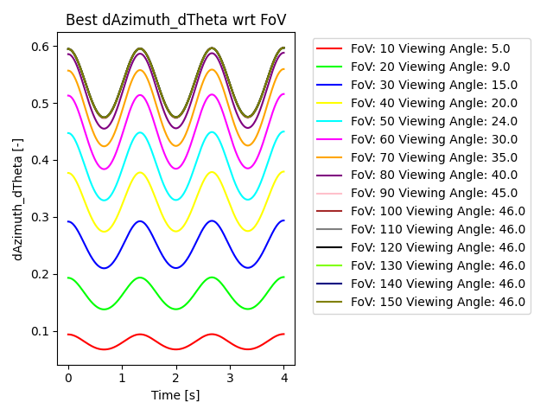
Maximum change for Azimuth

Slide 19
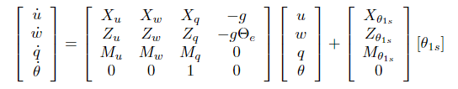

Pilot Model- Controlled dynamics
Start with linearised trimmed equations [1]:
Assume height is fixed and X_q*q <<X_u*u
[1] AN INVESTIGATION OF PILOT MODELLING FOR HELICOPTER HANDLING QUALITIES ANALYSIS – Helen Marie Baker

Slide 20
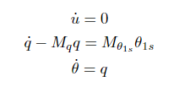

Pilot Model- Controlled dynamics
Assume u and u_dot are 0:
Laplace transform and rearrange:

Slide 21
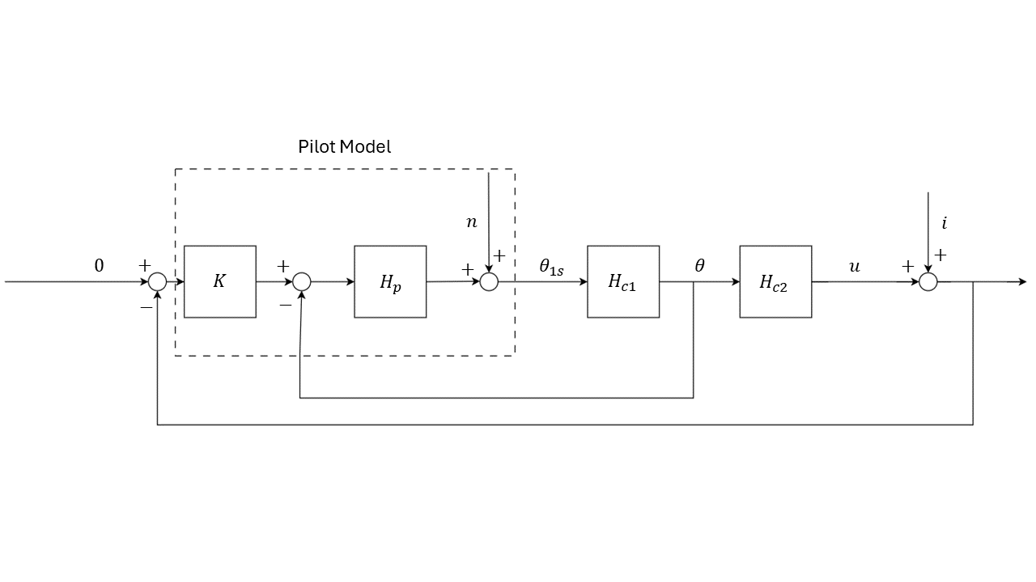

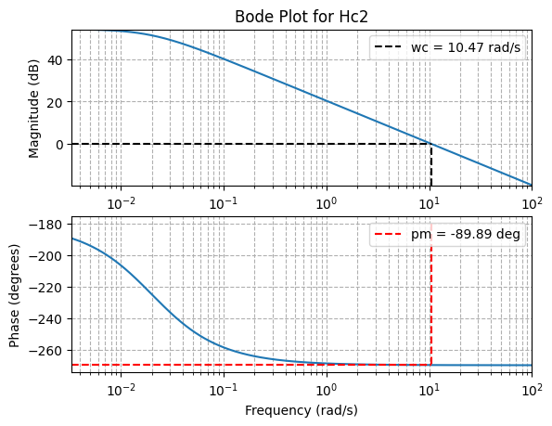


Pilot Model – Controlled Dynamics
Assume Hc1 = 1
Use steady state of Hc1 to derive Hc2:

Slide 22
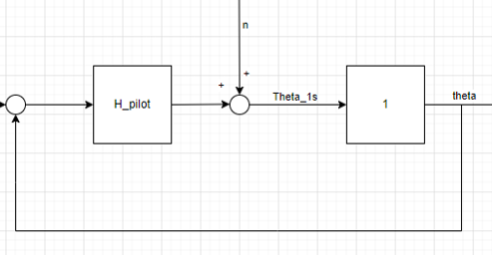
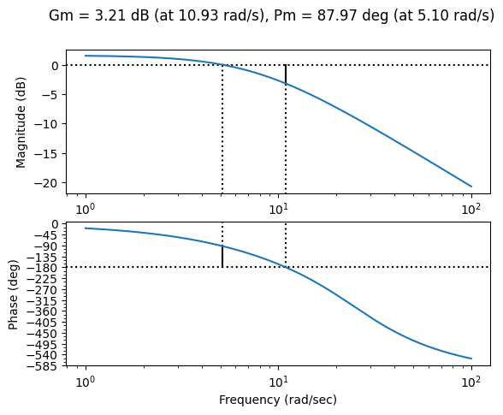
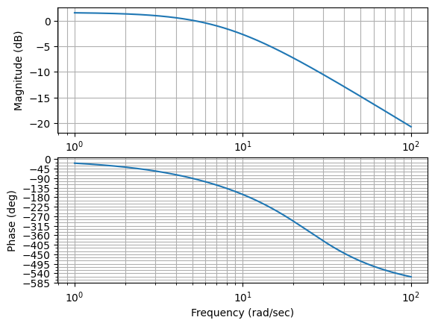

Forcing function
$\frac{Kpⅇ^{−τ_{e}s}}{1+τ_{I}s}$ = H_pilot
Kp = 1.2
Tau_e = 0.2
Tau_I = 0.13

Slide 23
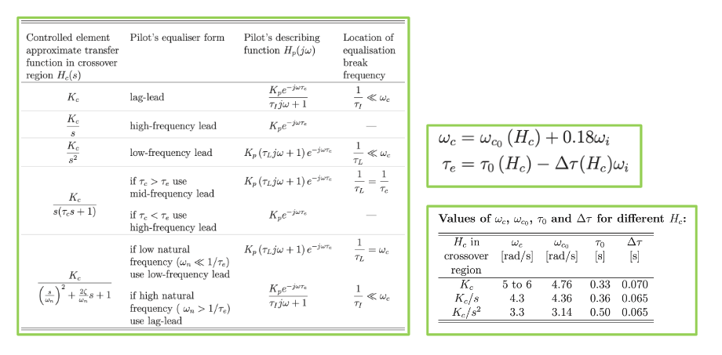

Forcing Function
Wi_inner = 1.90 rad/s
Wi_outer = 0.63 rad/s
T_m = 120 s

Slide 24
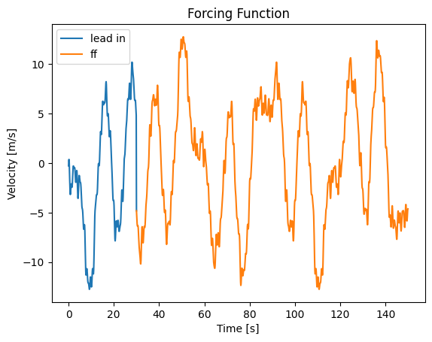
Forcing Function
N_t | w_t [rad/s] | A_t [m/s] | Phi_t [rad]
3 | 0.15707963 | 5 | -1.57657536
7 | 0.36651914 | 5 | 5.66384301
11 | 0.57595865 | 5 | 2.91532185
17 | 0.89011791 | 0.5 | 2.91532185
23 | 1.20427718 | 0.5 | -4.32259724
37 | 1.93731546 | 0.5 | -4.32290035
51 | 2.67035375 | 0.5 | -5.55328511
73 | 3.82227106 | 0.5 | 4.60150515
103 | 5.39306738 | 0.5 | 1.27064871
139 | 7.27802298 | 0.5 | 2.61471712

Slide 25
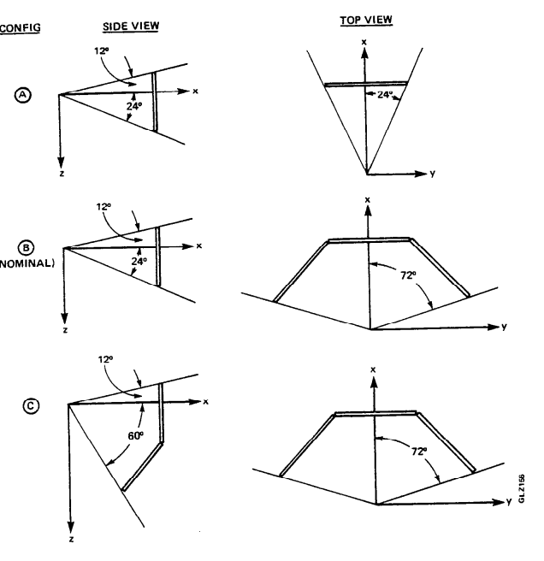
Chosen FoV- literature
Orientation specific FoVs:
Car moving in a straight line: 35x24 ◦ (narrow, front window only), 115x24 ◦ (full front window view) and 199x28 ◦ (full front and side-view) [1]
Computer Screen setup [2]
[1] “Speed perception affected by field of view: Energy-based versus rhythm-based processing – B.Lidestam
[2] PILOT/VEHICLE MODEL ANALYSIS OF VISUAL AND MOTION CUE REQUIREMENTS IN FLIGHT SIMULATION. – S.Baron

Slide 26
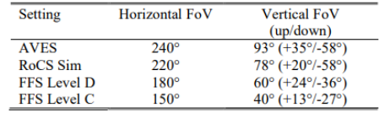
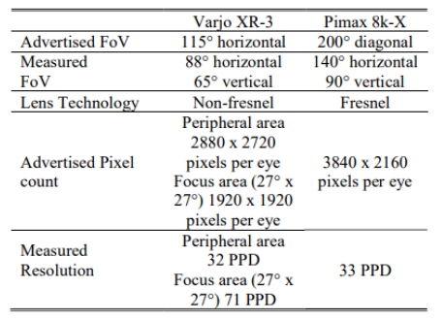
Chosen FoV- literature
Range based FoVs:
DLR simulator:
Pimax specific:
[1] Evaluation of Simulator Cueing Fidelity for Rotorcraft Certification by Simulation - DLR

Slide 27
Chosen FoV- literature
Range Based FoVs:
30, 60, 230 degrees – For rotations, 30 degrees is sufficient and for forward motion, 40 degrees is sufficient. Not much gain beyond 60 degrees [1]
10,20,40,80,120 degrees for a roll control experiment. Effective time delay decreases from 10 till 40. Reduction in time delay is minimal until 120 [2]
[1] Influence of the size of the field of view on motion perception– Pretto
[2] The effects of field of view size on the control of roll motion – R. Kenyon

Slide 28
Chosen FoVs
One FoV is 20 degrees
Below 30 performance degrades for translations and rotations [1][2]
Then 30, 60, 120 and 140 degrees
40 is considered sufficient for forward motion. Not much gain after 60 [1]
[1] Influence of the size of the field of view on motion perception– Pretto
[2] The effects of field of view size on the control of roll motion – R. Kenyon

Slide 29
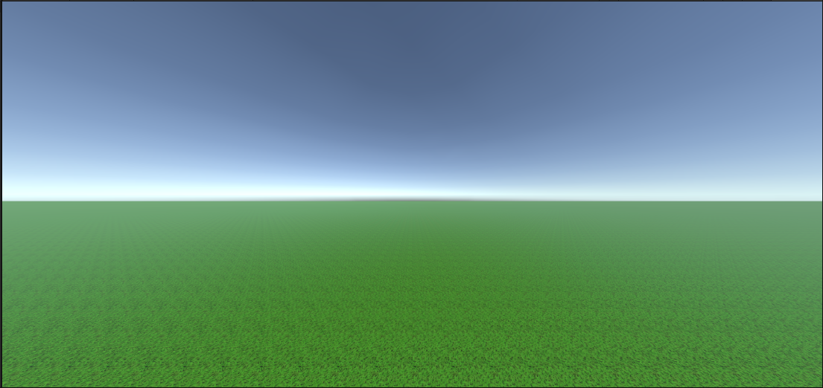
Visuals

Slide 30
Experiment
Joystick goes from -1 to 1.
Translates to 30 degree pitch

Slide 31
This week
Finish midterm report
Submit documents for Human Research Ethics

Slide 32
Questions
Is Pimax CE certified?
Date for Midterm presentation
BBQ

Slide 33


Slide 34
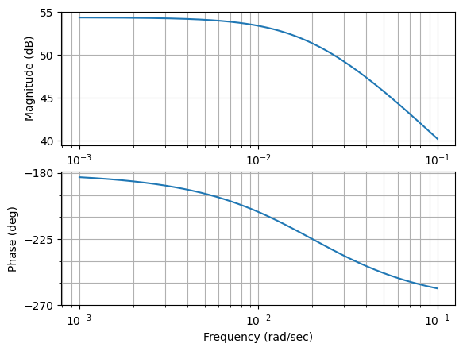

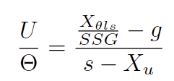
Vehicle model
Assume
Use steady state gain to get second transfer
function
X_theta1s = -9.280 m/s^2 rad
X_u = -0.02 s^-1
SSG = 13.9

Slide 35
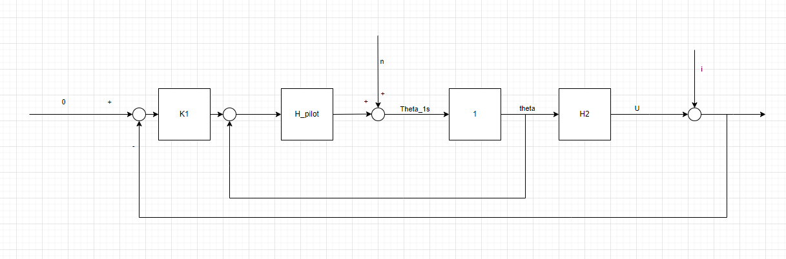
Cybernetic model

Slide 36
Forcing Function
Closed inner loop ?
Guessed the pilot gain
Found the crossover frequency
Used McRuer’s equation to find forcing function bandwidth
1/3 rule to find outer loop bandwidth
Created range of frequencies ?
Chose a measurement time ?
Base frequency-> component frequencies ?
Scaled amplitudes ?

Slide 37
Forcing Function
N_d | W_d | A_d
5 | 0.261799 | 0.417035
11 | 0.575958 | 0.212192
23 | 1.204277 | 0.091223
37 | 1.937315 | 0.049619
51 | 2.670353 | 0.032685
71 | 3.717551 | 0.021457
101 | 5.288347 | 0.014048
137 | 7.173303 | 0.010038
171 | 8.953539 | 0.008034
226 | 11.83333 | 0.006244

Slide 38
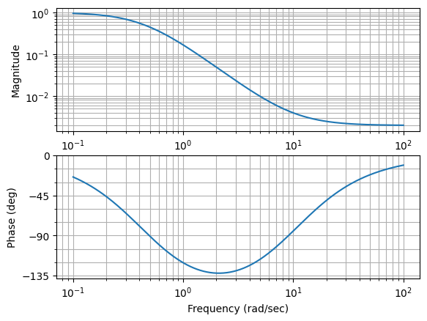

Forcing function
Ta1 = 0.1 Ta2 = 2.25

Slide 39
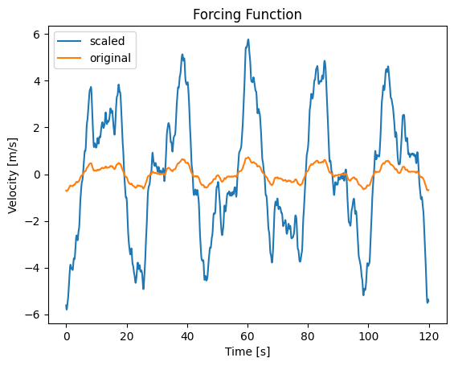
Forcing function
Variance = 1 [m/s^2]^2
N_d | W_d | A_d | A_d_scaled
5 | 0.261799 | 0.417035 | 3.325617
11 | 0.575958 | 0.212192 | 1.692117
23 | 1.204277 | 0.091223 | 0.727457
37 | 1.937315 | 0.049619 | 0.395687
51 | 2.670353 | 0.032685 | 0.260646
71 | 3.717551 | 0.021457 | 0.171113
101 | 5.288347 | 0.014048 | 0.112027
137 | 7.173303 | 0.010038 | 0.080055
171 | 8.953539 | 0.008034 | 0.064068
226 | 11.83333 | 0.006244 | 0.049812

Slide 40



Projection
Screen size
FoV
Horizontal position in the viewing plane
X coordinate of point P in the Viewing axis

Slide 41
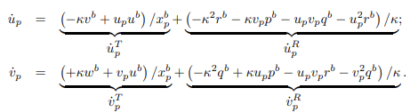
Projection
0
0
0

Slide 42
Parameter
Find location for maximum screen velocity / actual velocity
Ignore projection effects (kappa stays the same)
Find value for 1 DoF (u)
Find value for 2 DoF (u,theta)
Ensure that:
The projected element is always on screen for 1 Dof
For 2 dof, object is within the view frustum but can be projected off screen

Slide 43
Potential uses
Create a list of FoVs to test
Create list of most prominent objects for these FoVs
Link to Control structure?

Slide 44
Plan
Find a relevant vehicle model
Consider aspects such as where the disturbance is added (velocity)
Design a relevant task
Relevant forcing function
Visuals
Predict what the Cybernetic model will look like for this task
Predict what the model will look like as velocity perception goes to 0 with lower FoV
See if control loop is sensitive to velocity perception
Notes:
FoV tested: Pilot/Vehicle of Visual and Requirements Model Analysis Motion Cue in Flight Simulation by Sheldon baron
Degraded VC: Simplified approach for modelling pilot pursuit control behaviour in multi-loop flight control tasks by RA Hess

Slide 45
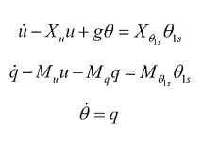
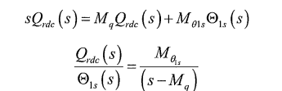

Vehicle model
Trimmed and linearised pitch and surge equations [1]:
In [1] they assume surge is 0 and then derive the tf from control input to q or theta
[1] AN INVESTIGATION OF PILOT MODELLING FOR HELICOPTER HANDLING QUALITIES ANALYSIS – Helen Marie Baker
M_theta1s = 26.4
M_q = -1.8954

Slide 46
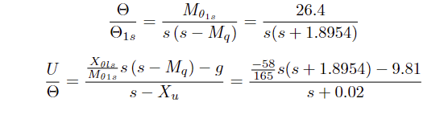
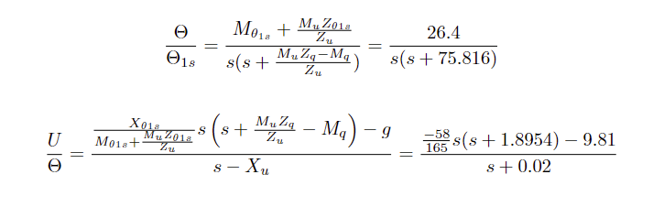
Vehicle model

Slide 47
Variables
Independent variable-> Pilot FoV
Pimax 8k has a diagonal Fov of 200 degrees
Actual specs: https://risa2000.github.io/hmdgdb/
Collected data
Time traces of error, input, velocity and position
Subjective workload rating (Bedford rating scale)

Slide 48
Forcing function
Sum of sinusoids
Applied to the velocity
T_m between 50-100 seconds [1][2][3]
Apply low pass filter on the amplitudes. [2]
Choice of T_m, n_d and phi?
[1] AN INVESTIGATION OF PILOT MODELLING FOR HELICOPTER HANDLING QUALITIES ANALYSIS – Helen Marie Baker
[2] A Cybernetic Approach to Assess Flight Simulator Motion Fidelity – Pool et al
[3] Effects of Aeroelasticity on the Pilot’s Psychomotor Behavior – Groot et al

Slide 49
Experiment visuals

